Slide 1
Deep Learning-based Framework for Accurate Clothing Attribute Recognition and Style Navigation for Gait Recognition
Dr. Anubha Parashar

Slide 2
Contents
Introduction
Literature Review
Objectives
Methodology
Results
Conclusion
References

Slide 3
INTRODUCTION
Extraction of information has become more constant due to availability of large amounts of image data and e-commerce.
Recognizing attributes in an image is gaining recognition to forecast tasks.
Our paper mainly focuses on recognizing attributes related to clothing which are built using Deep CNN.
Our framework has a lot of applications like retrieving and navigating on basis of style, labeling of clothing pieces according to personalized style.

Slide 4
Literature Review
Studies prior to our paper were mainly concerned with textures and their distribution in pattern, color of the theme in low features which were based on pixels to search for connection. They were unable to apprehend the characteristics of visual aspect to identify the attributes of clothing.
In order to resolve these issues, we are presenting a method based on ResNet to identify various clothing attributes like waists, collars, front buttons, lengths, and sleeves.

Slide 5
Objectives
To make the selective search algorithm more efficient in extracting main parts of clothing, we make changes to improve the methods for calculating texture and color similarity.
To classify features from region of candidates using a classifier which works on L-softmax loss, sparse CNN.

Slide 6
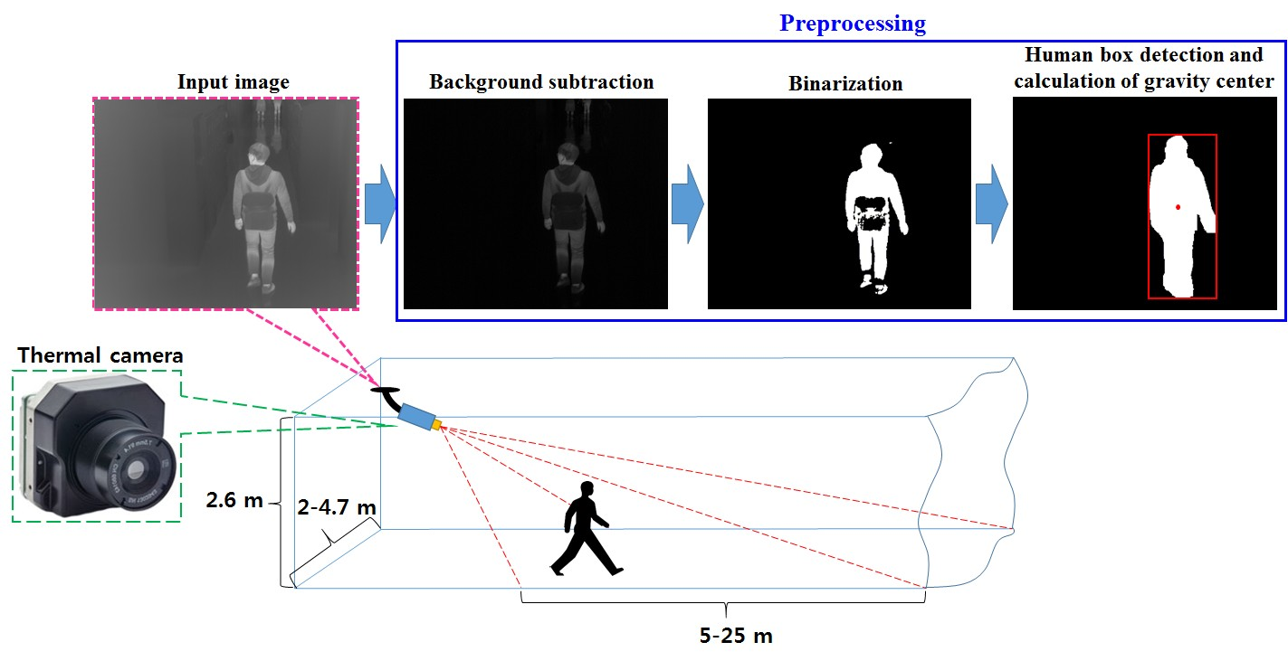
Methodology

Slide 7
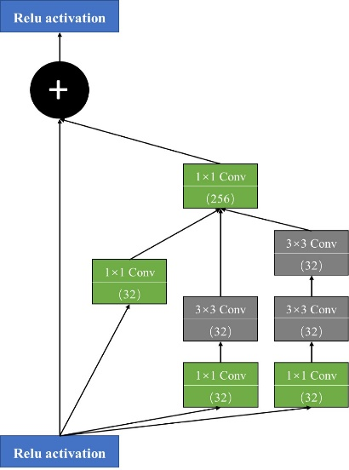
Methodology

Slide 8
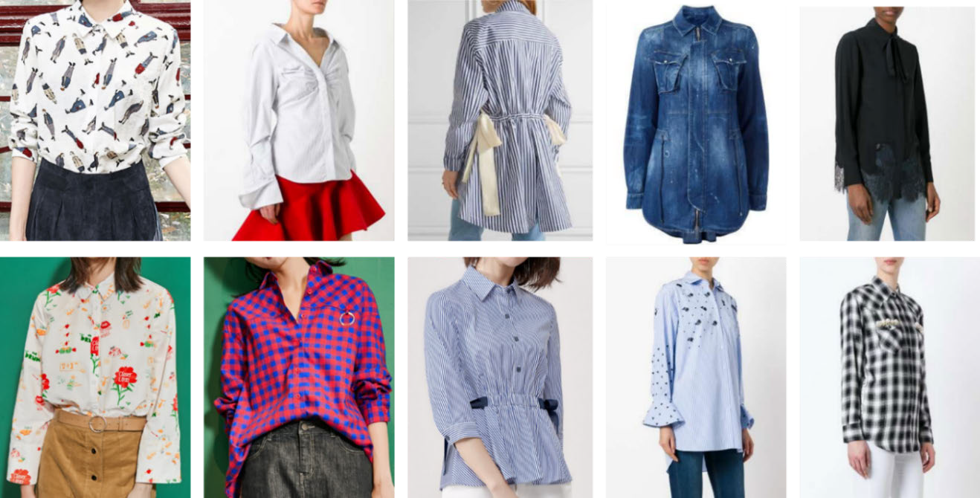
Dataset

Slide 9
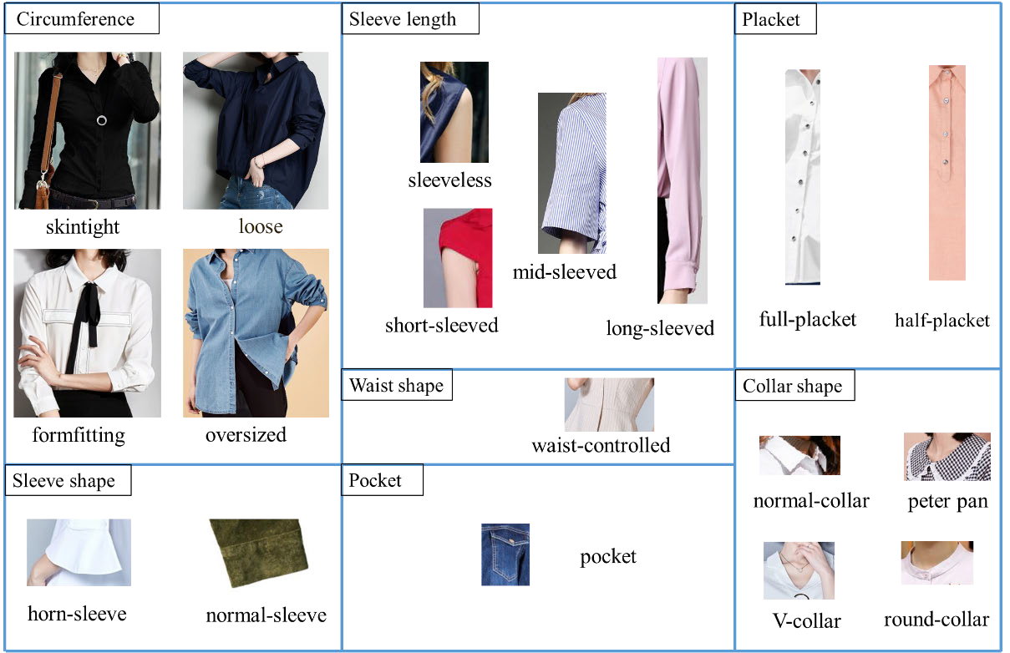
Dataset

Slide 10
Algorithm
Steps for input of images are as follows,
R = {r1, r2 · · · rn} is the set which is used to acquire initial region with the use of segmentation procedures built on graphs.
size, color and texture resemblance are stored in a set S are used for similarity calculation.
Rq and rp are combined inn set R to produce rt and similarity between rq and rp is deleted.
Rt was stored in R set to calculate resemblance between regions adjacent and rt.
The last two steps are iterated till set S is empty.
Candidate packs are filtered according to size.

Slide 11
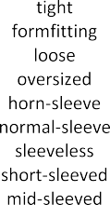

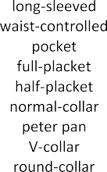

Results

Slide 12
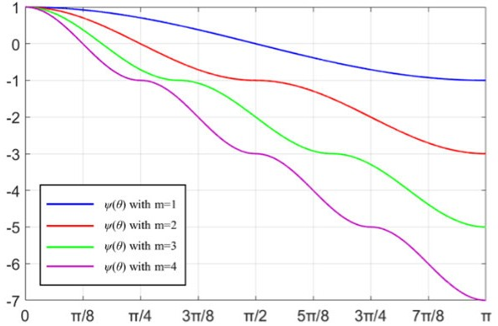
Results

Slide 13
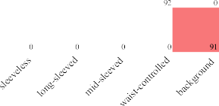





Results

Slide 14
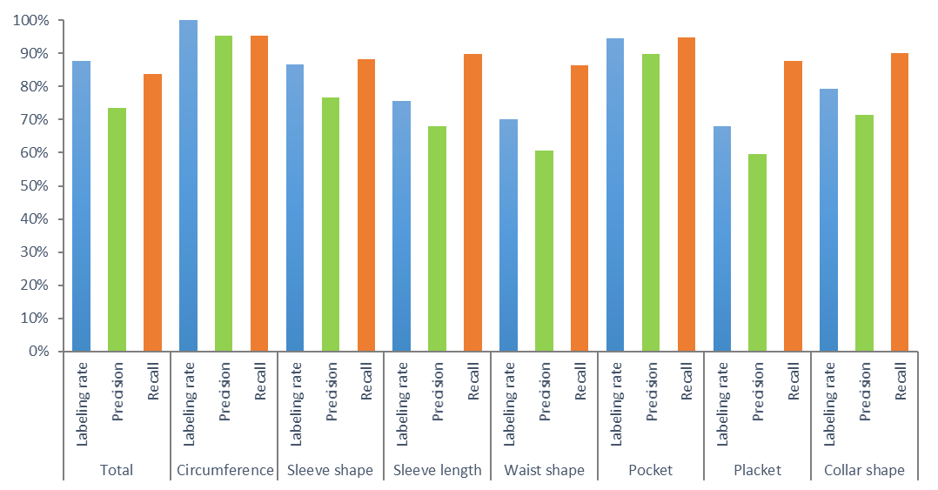
Results

Slide 15
Results
Methods | AUC | EER
CGI + PCA + LDA [1] | 20.73 | 71.18
CGI [2] + VGG Net-19 | 95.2 | 10.42
CGI [3] + VGG Net-19 + CNN-LSTM | 99.41 | 3.01
GEI + RT + PCA [4] | 34.82 | 60.53
GEI [5] + VGG Net-19 | 96.47 | 10.18
GEI [6] + VGG Net-19 + CNN-LSTM | 98.19 | 5.72
Contour-width-based + spatio-temporal smoothing + DTW [7] | 22.66 | 69.55
Contour-width-based + spatio-temporal smoothing [8] + VGG Net-19 | 95.62 | 10.9
Proposed feature + VGG Net-19 | 97.49 | 8.17
Proposed method | 99.71 | 2.61

Slide 16
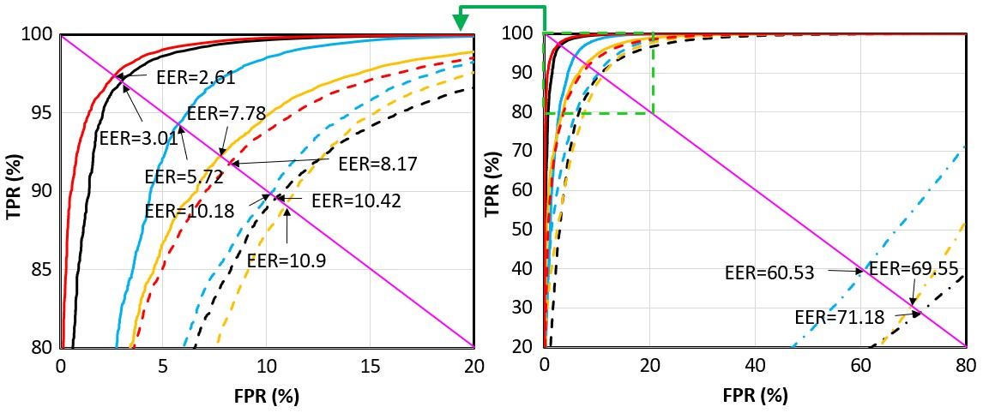
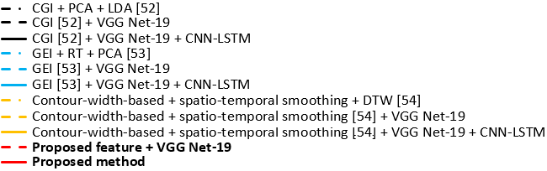
Results

Slide 17
Conclusion
We have produced a new framework to extract the regions of attribute and clothing features by keeping precision and time of training in mind. First and foremost, algorithm of selective search is used for extracting target regions. After that L-softmax and ResNet are utilized for extracting attribute region and speculating the classification.

Slide 18
References
[1] T. Yeoh, H. E. Aguirre, and K. Tanaka, “Clothing-invariant gait recognition using convolutional neural network,” in 2016 International Symposium on Intelligent Signal Processing and Communication Systems (ISPACS), Oct. 2016, pp. 1–5, doi: 10.1109/ISPACS.2016.7824728.
[2] M. Alotaibi and A. Mahmood, “Reducing covariate factors of gait recognition using feature selection and dictionary-based sparse coding,” Signal, Image Video Process., vol. 11, no. 6, pp. 1131–1138, Sep. 2017, doi: 10.1007/s11760-017-1067-x.
[3] F. M. Castro, M. J. Marín-Jiménez, N. Guil, and N. P. de la Blanca, “Automatic learning of gait signatures for people identification,” in Lecture Notes in Computer Science (including subseries Lecture Notes in Artificial Intelligence and Lecture Notes in Bioinformatics), vol. 10306 LNCS, 2017, pp. 257–270.
[4] S. Tong, Y. Fu, and H. Ling, “Verification-based pairwise gait identification,” in 2017 IEEE International Conference on Multimedia and Expo Workshops, ICMEW 2017, Jul. 2017, no. July, pp. 669–673, doi: 10.1109/ICMEW.2017.8026299.
[5] T. W. Yeoh, H. E. Aguirre, and K. Tanaka, “Stacked progressive auto-encoders for clothing-invariant gait recognition,” in Lecture Notes in Computer Science (including subseries Lecture Notes in Artificial Intelligence and Lecture Notes in Bioinformatics), vol. 10425 LNCS, no. 1, 2017, pp. 151–161.
[6] Y. Sun and Q. Liu, “Attribute recognition from clothing using a Faster R-CNN based multitask network,” Int. J. Wavelets, Multiresolution Inf. Process., vol. 16, no. 02, p. 1840009, Mar. 2018, doi: 10.1142/S021969130.1007\%2F978-3-319-161811840009X.
[7] F. Yang, X. Jiang, T. Sun, and K. Xu, “Gait recognition with clothing and carrying variations based on GEI and CAPDS features,” in Lecture Notes in Computer Science (including subseries Lecture Notes in Artificial Intelligence and Lecture Notes in Bioinformatics), vol. 11858 LNCS, 2019, pp. 632–643.
[8] X. Li, Y. Makihara, C. Xu, Y. Yagi, and M. Ren, “Joint Intensity Transformer Network for Gait Recognition Robust Against Clothing and Carrying Status,” IEEE Trans. Inf. Forensics Secur., vol. 14, no. 12, pp. 3102–3115, Dec. 2019, doi: 10.1109/TIFS.2019.2912577.

Slide 19
THANK YOU
Dr. Anubha Parashar
anubhaparashar1025@gmail.com
https://anubhaparashar.github.io/

